Slide 1
Segmenting & Clustering Neighbourhoods in Fredericton

Slide 2
Introduction
Developers, investors, policy makers and/or city planners have an interest in answering the following questions as the need for additional services and citizen protection:
What neighbourhoods have the highest crime?
Is population density correlated to crime level?
Using Foursquare data, what venues are most common in different locations within the city?
Does the Knowledge Park really need a coffee shop?

Slide 3
Data Acquisition
To understand and explore we will need the following Open Data sources:
Open Data Site: http://data-fredericton.opendata.arcgis.com/
Fredericton Neighbourhoods: http://data-fredericton.opendata.arcgis.com/datasets/neighbourhoods--quartiers
Fredericton Crime by Neighbourhood: http://data-fredericton.opendata.arcgis.com/datasets/crime-by-neighbourhood-2017--crime-par-quartier-2017
Fredericton Census Tract Demographics: http://data-fredericton.opendata.arcgis.com/datasets/census-tract-demographics--donn%C3%A9es-d%C3%A9mographiques-du-secteur-de-recensement
Fredericton locations of interest: https://github.com/JasonLUrquhart/Applied-Data-Science-Capstone/blob/master/Fredericton%20Locations.xlsx

Slide 4
Methodology
The methodology will include:
Loading each data set
Examine the crime frequency by neighbourhood
Study the crime types and then pivot analysis of crime type frequency by neighbourhood
Understand correlation between crimes and population density
Perform k-means statisical analysis on venues by locations of interest based on findings from crimes and neighbourhood
Determine which venues are most common statistically in the region of greatest crime count then in all other locations of interest.
Determine if an area, such as the Knowledge Park needs a coffee shop.

Slide 5
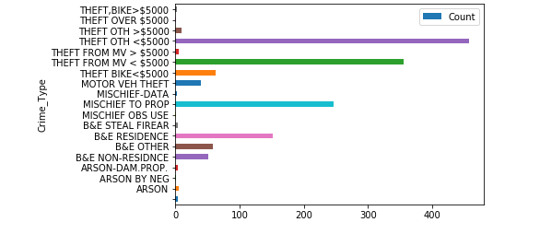
Results
Other theft less than $5000 was the most common crime
Motor vehicle theft less than $5000 was the second most common

Slide 6
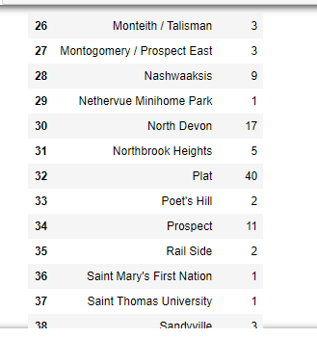
Results
Analysis of crime by suburb resulted in the suburb of ‘Plat’
Population density was not strongly correlated to crime frequency

Slide 7
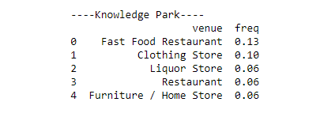
Results
73 unique venue categories
153 unique venues
Able to print the top 5 most common venues in each location
Currently no coffee shops in Knowledge park therefore it may be appropriate to open one

Slide 8
Conclusion and Future Directions
Able to understand crime type and frequency by area but we do not understand the distribution properties
Theft from motor vehicles is the most prevalent crime in these areas
Knowledge park does not currently have a coffee shop, so it may be beneficial to open one there
Future Direction / Ideas
Issues with open data sources, more scope to fix this for more accurate data
Issues with combining data sets between crime neighbourhoods – more specific coding (timestamp and date) may be beneficial

